Slide 1
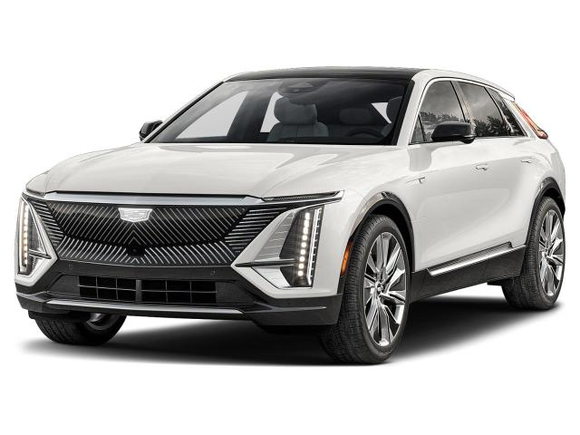
Electric Vehicles
Janae Foster

Slide 2
Introduction
With the debate on how to help with global warming by reducing the carbon footprint. EV reduces carbon pollution by 24%
My thoughts were what can the average person contribute without much sacrifice
Is there an EV for all body styles?
How much range does an EV have?
What perks are associated with an EV?

Slide 3

Stereotype VS Facts
Electric cars are stereotyped to have little variety in style, higher maintenance cost, difficulty in locating charging stations, short travel range
BEV typical range from 150 to 400 miles
There are over 450 EV models available
All-electric vehicles typically require less maintenance than conventional vehicles
The battery, motor, and associated electronics require little to no regular maintenance
There are fewer fluids, such as engine oil, that require regular maintenance
There are far fewer moving parts relative to a conventional fuel engine.
Maintenance cost range around $45 monthly, or $500 a year for every 15,000 miles

Slide 4
Analysis
Imported two CSV files into python
Imported libraries pandas, NumPy and seaborn
Dropped columns in both CSV files eliminating unnecessary data
Sources
EVs - One Electric Vehicle Dataset - Smaller | Kaggle
Electric Vehicle Market Size, Share, Trends, Growth Report 2030 (marketresearchfuture.com)
Buying and Driving Fuel Efficient and Alternative Fuel Vehicles | Department of Energy

Slide 5
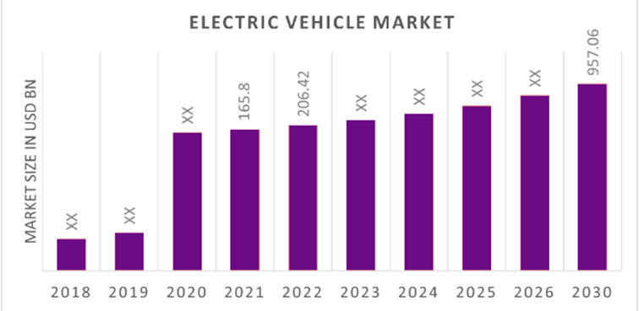
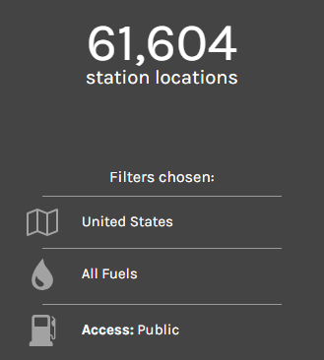
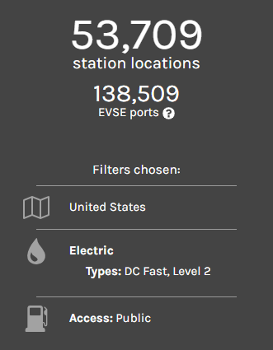
Charging Stations
Government Incentives
Tax Credit $2,500 -$7,500 rebate on EV (select vehicles)
Businesses a rebate of $5,000 per port
Funding installing a charging station at home
Example
HF Lake Mary Office
Shopping Centers (Mall, Target, etc.)
Hospitals
Parking Garages

Slide 6

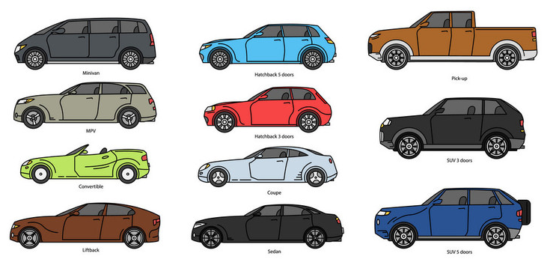
EV Range
An average vehicle ranges 257 miles, this means that the average all-electric vehicle is 3.51 times more efficient than its conventional counterpart.

Slide 7
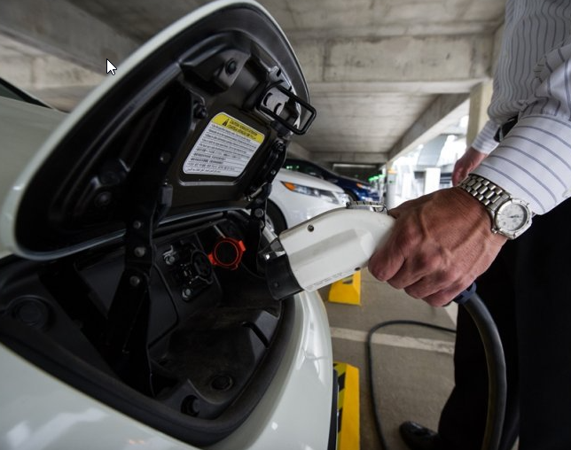
Conclusion
EV are vastly growing every year by 26%
Government assistance and funding is available and varies per state.
Rebates are available for both EV and Hybrid
EV have designs for almost all body types
EV ranges are either equal or passes a conventional vehicle
As we continue to find ways to make to save our planet the air pollution strives when there are less vehicles on the road, eclectic vehicles has its downsides to our environment, but it also has a lot benefits. EV owners tend to spend 60% less each year on cost compared to gas powered vehicles.

